Slide 1
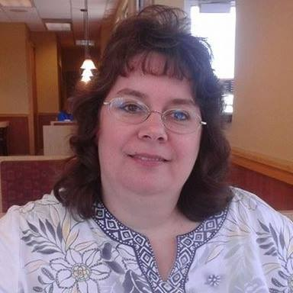
Disaster Planning: Safeguarding Your Genealogical Records
Melissa Barker, Certified Archives Manager

Slide 2
The content of this video, as well as the thoughts, views, and opinions expressed herein belong solely to the creator and do not necessarily reflect the views of FamilySearch International and RootsTech.

Slide 3
Genealogists Are Home Archivist

Slide 4
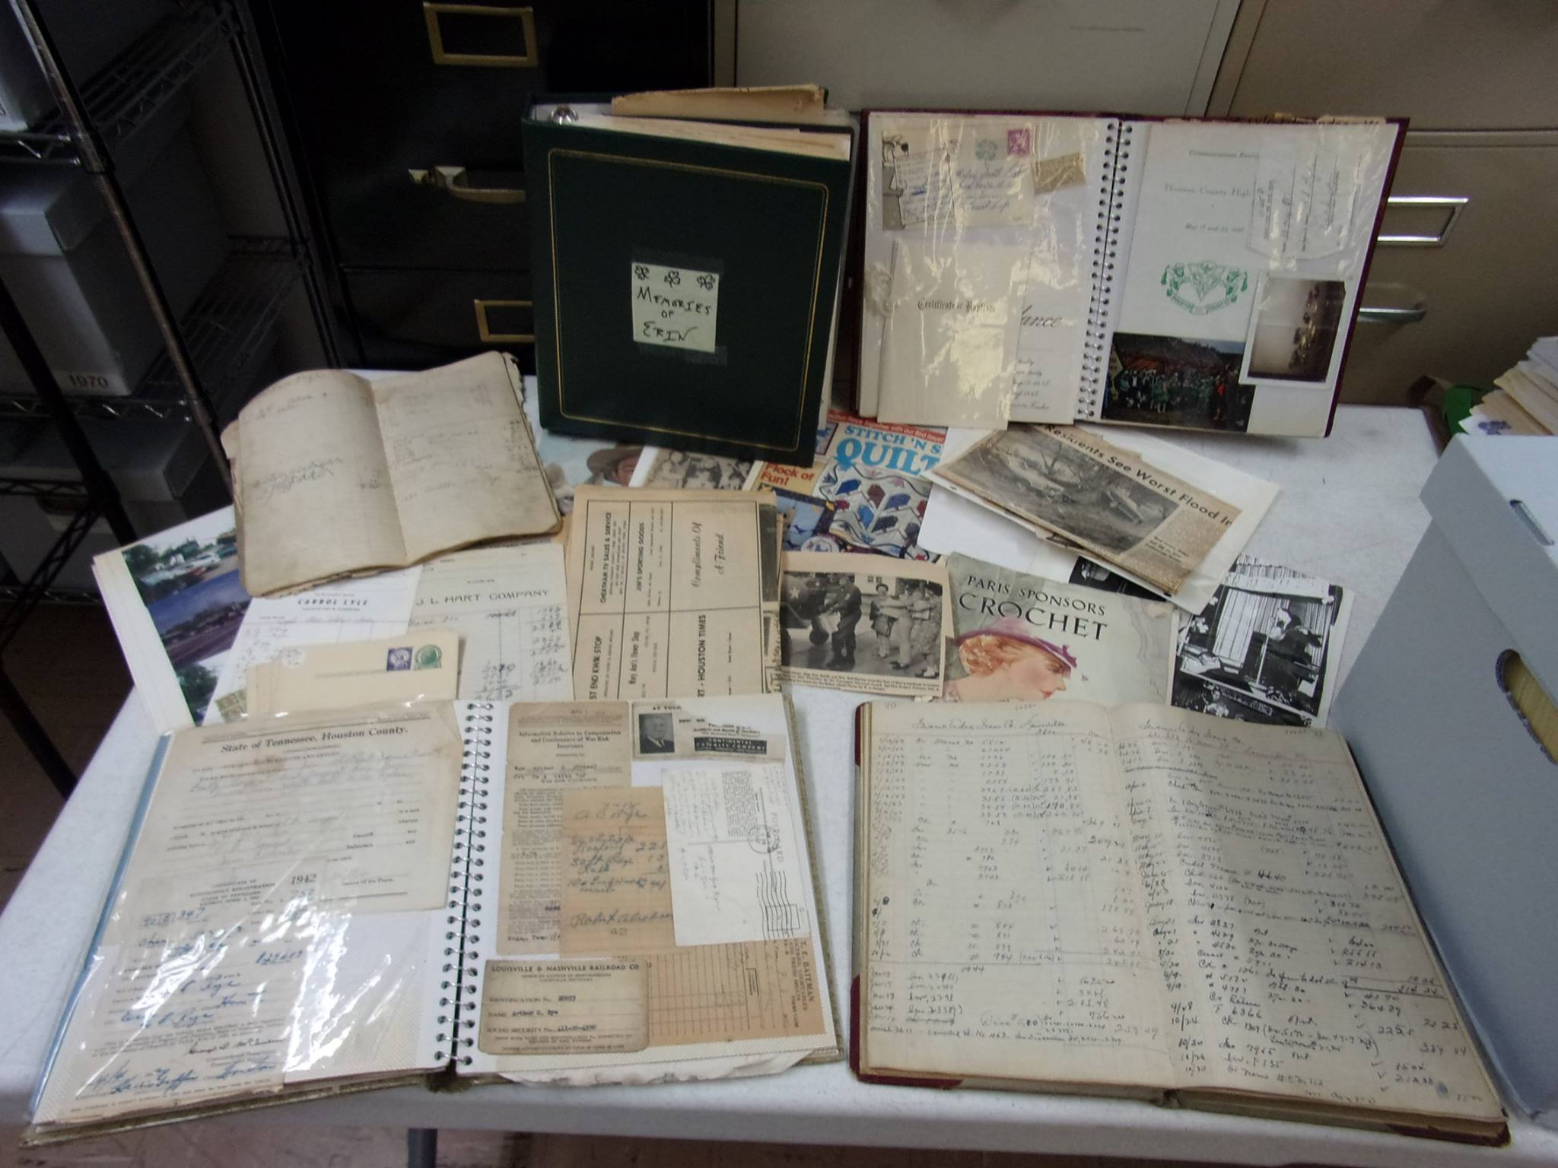
Collect Historical & Genealogical Records
Lyle Family Records Collection, photo courtesy of Melissa Barker

Slide 5
Genealogists are Home Archivists
Collect Historical & Genealogical Records
Collect Photographs

Slide 6
Genealogists are Home Archivists
Collect Historical & Genealogical Records
Collect Photographs
Receive “Donated” Records from Others

Slide 7
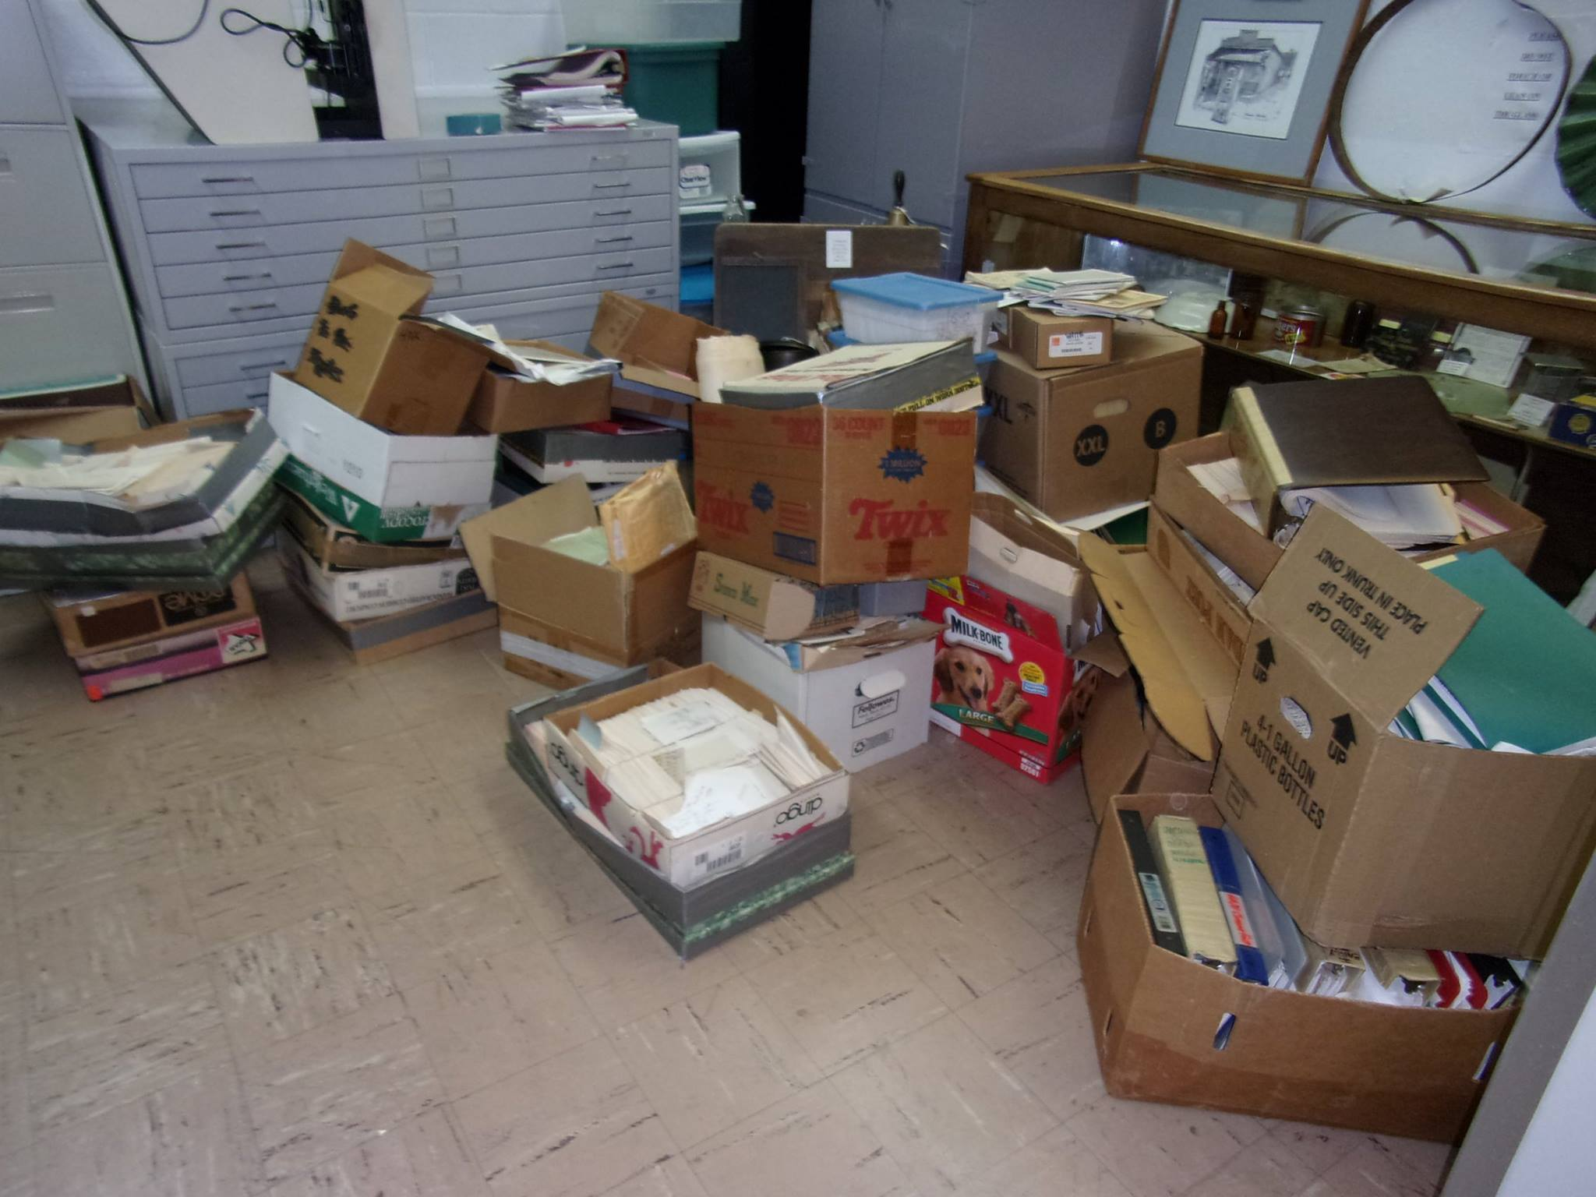
Late Historian Nina Finley’s Records Collection, photo courtesy of Melissa Barker

Slide 8
Collect Historical & Genealogical Records
Collect Photographs
Receive “Donated” Records from Others
Organize and Preserve Records, Photographs and Ephemera

Slide 9
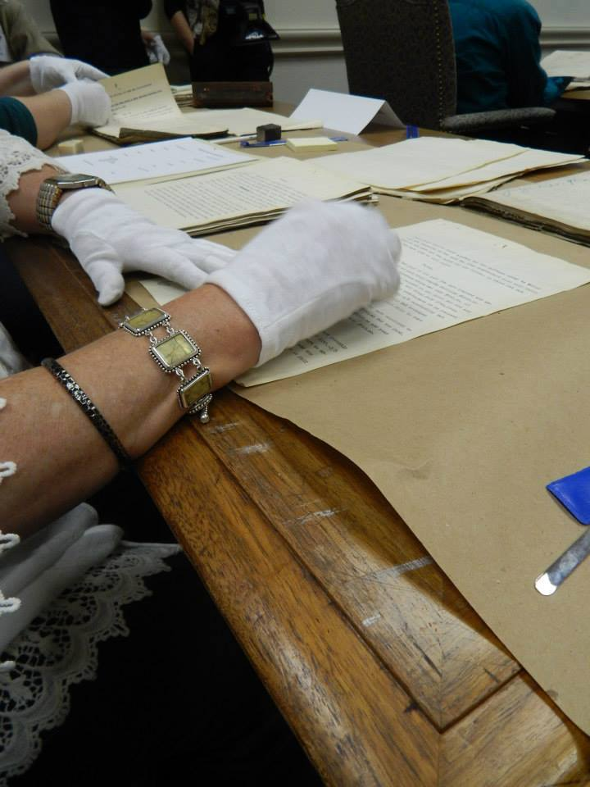
Cleaning Tennessee Supreme Court Records at the Tennessee State Library and Archives, Photo courtesy of Melissa Barker

Slide 10
Disaster Preparedness Plan
Most archives have a Disaster Plan in place and it is reviewed annually.

Slide 11
Disaster Preparedness Plan
If archives are concerned about preparing for disasters, genealogists should also be concerned and prepare for a disaster that could affect their own genealogical records.

Slide 12
Natural Disasters
A natural disaster can be defined as:
A major adverse event resulting from the natural process of the Earth.

Slide 13
Natural Disasters
Unfortunately, we live in a world where there are natural disasters that happen to us all. Some are more prevalent to certain regions of the globe, while others happen just about anywhere these days. We must be prepare and preserve our genealogical records.

Slide 14
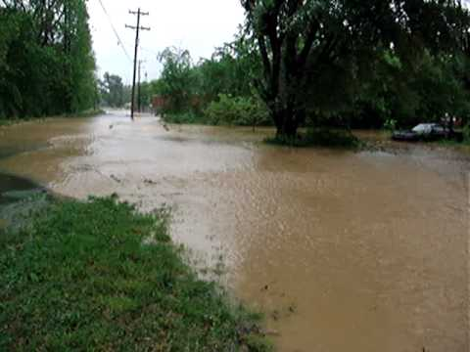
Natural Disasters
Floods
Houston County, TN. Flood of May 2, 2010, photo courtesy of Melissa Barker

Slide 15
Natural Disasters
Floods
Tornados

Slide 16
Natural Disasters
Floods
Tornados
Hurricanes

Slide 17
Natural Disasters
Floods
Tornados
Hurricanes
Earthquakes

Slide 18
Natural Disasters
We cannot control natural disasters. Sometimes we have warnings they are coming but other times they happen suddenly and without warning.
Genealogists/Home Archivist need to be prepared.

Slide 19
Man-Made Disasters
Man-Made Disasters or sometimes called Human-Made Disasters can be defined as:
A disastrous event caused directly or indirectly by one or more human actions.

Slide 20
Man-Made Disasters
Water leaks that cause flooding in the home

Slide 21
Man-Made Disasters
Water leaks that cause flooding in the home
Moisture that causes mold in the home

Slide 22
Man-Made Disasters
Water leaks that cause flooding in the home
Moisture that causes mold in the home
Fire

Slide 23
Man-Made Disasters
Water leaks that cause flooding in the home
Moisture that causes mold in the home
Fire
Computer Melt Down

Slide 24
Man-Made Disasters
In some cases, we can prevent man-made disasters in our homes which will safeguard our genealogical records.

Slide 25
Digitization
The #1 step any genealogists/home archivist can take to keep the information on genealogical records safe from natural and man-made disasters.

Slide 26
Digitize all original records first and then digitize copied records
Use a flat bed scanner or digital camera
Do not use self feeding scanning devices for original or delicate documents
Put the digitized records on an external device such as an external hard drive, thumb drive, etc.
Save the digitized records in an online cloud-based storage site

Slide 27
Digitization
Digitizing our genealogical records will save the information contained on those documents. While this may not save the original records themselves when disaster strikes, this is the best way to preserve the information.

Slide 28
Get the Records Out of the House

Slide 29
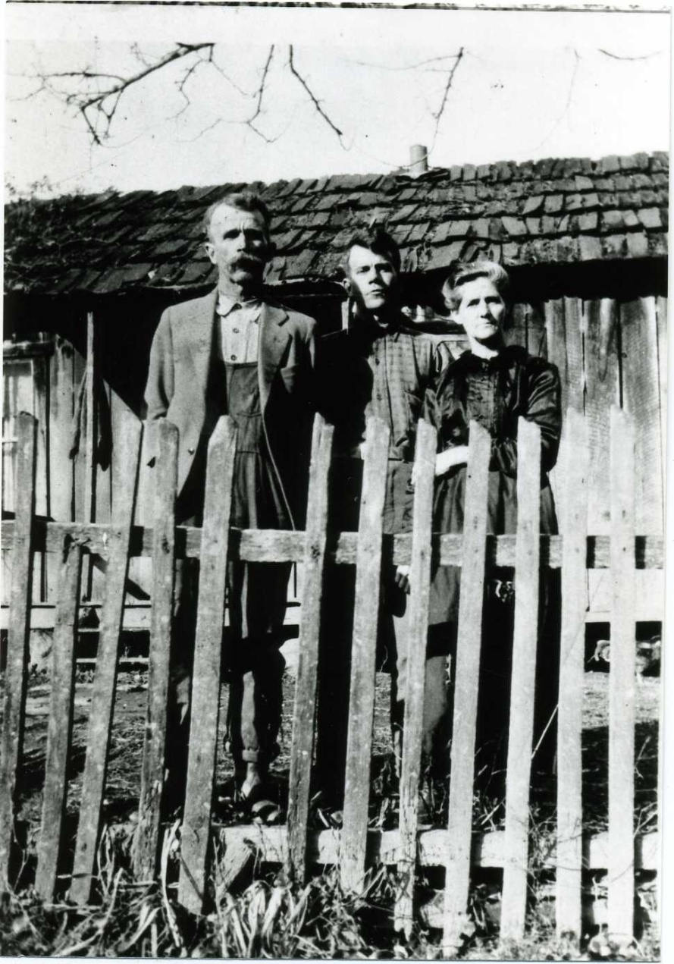
Give a copy of digitized records to 3 relatives or friends
Harley Boatright and Parents, courtesy Melissa Barker Family Photos

Slide 30
Give a copy of digitized records to 3 relatives or friends
Place a copy of the digitized records in a safe deposit box at the bank

Slide 31
Give a copy of digitized records to 3 relatives or friends
Place a copy of the digitized records in a safe deposit box at the bank
Donate a copy of the digitized records to the local archives, library, historical society, genealogical society, etc.

Slide 32
Protecting the Original Records

Slide 33
Climate Controls

Slide 34
Do not store records in a basement, attic or garage

Slide 35
Do not store records in a basement, attic or garage
Store records in the coolest part of the house, temperatures should be between 35°-65° F

Slide 36
Do not store records in a basement, attic or garage
Store records in the coolest part of the house, temperatures should be between 35°-65° F
Temperatures should be steady and do not fluctuate

Slide 37
Do not store records in a basement, attic or garage
Store records in the coolest part of the house, temperatures should be between 35°-65° F
Temperatures should be steady and do not fluctuate
Store records where humidity levels are at 30%-50% to slow deterioration rate of the paper

Slide 38
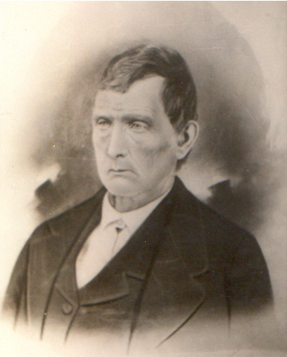
Keep records and photographs out of direct sunlight. Sunlight is one of the most damaging elements to genealogical records.
Benjamin DeBolt 1810-1890, courtesy Melissa Barker Family Photos

Slide 39
Tips from an Insurance Adjustor (My Husband)

Slide 40
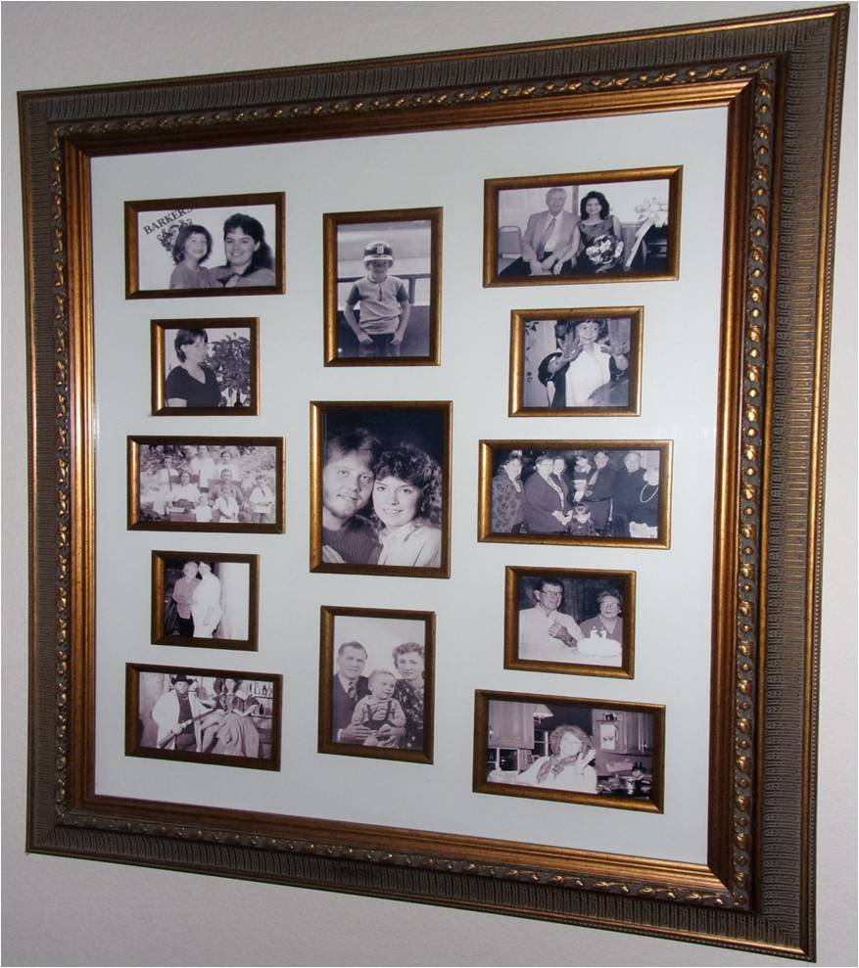
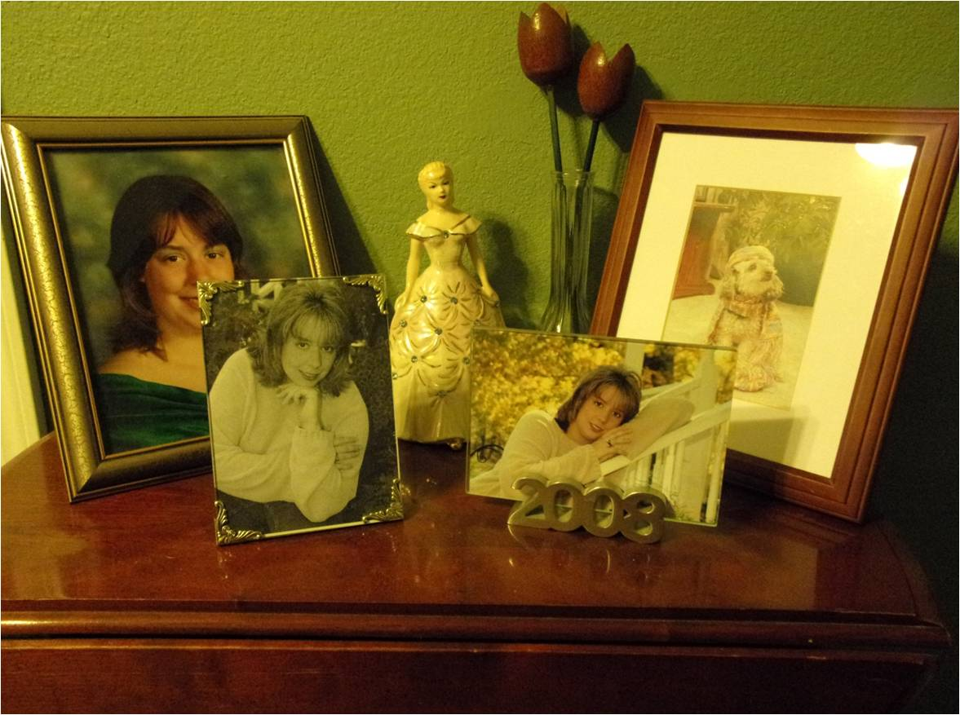
Never frame original photographs, obtain good copies and frame the copies
Photos courtesy of Melissa Barker Family Photos

Slide 41
Never frame original photographs, obtain good copies and frame the copies
Do not leave burning candles unattended. Consider using candle warmers or no candles at all

Slide 42
Never frame original photographs, obtain good copies and frame the copies
Do not leave burning candles unattended. Consider using candle warmers or no candles at all
Never leave the clothes dryer running while away from home or sleeping

Slide 43
Never frame original photographs, obtain good copies and frame the copies
Do not leave burning candles unattended. Consider using candle warmers or no candles at all
Never leave the clothes drying running while away from home or sleeping
Never leave the dishwasher or clothes washer running while away from home or sleeping

Slide 44
If you have space or wall heaters, do not leave anything lying on top of it or stored in front of it, especially boxes of records

Slide 45
If you have space heaters, do not leave anything lying on top of it or stored in front of it, especially boxes of records
Keep Christmas trees well hydrated

Slide 46
If you have space heaters, do not leave anything lying on top of it or stored in front of it, especially boxes of records
Keep Christmas trees well hydrated
Do not leave boxes of records or photographs on the floor, store them on shelves

Slide 47
If you have space heaters, do not leave anything lying on top of it or stored in front of it, especially boxes of records
Keep Christmas trees well hydrated
Do not leave boxes of records or photographs on the floor, store them on shelves
Do not overload extension cords or wall sockets with electronics

Slide 48
Disaster Planning
None of us want to experience a natural disaster or a man-made disaster that damages or destroys our genealogical records.
Putting a disaster plan in place and making sure our genealogical records are safe is our only option.

Slide 49
Thank You!

Slide 50
Visit my Blog: “A Genealogist in the Archives” http://agenealogistinthearchives.blogspot.com/ Visit “The Archive Lady” on Facebook https://www.facebook.com/TheArchiveLady/

Slide 51
Please email me with any questions about genealogy research, researching in archives or records preservation: melissabarker20@hotmail.com

